Slide 1


SAP S/4HANA CDS, SAC Training Day 12
Anubhav Oberoy

Slide 2
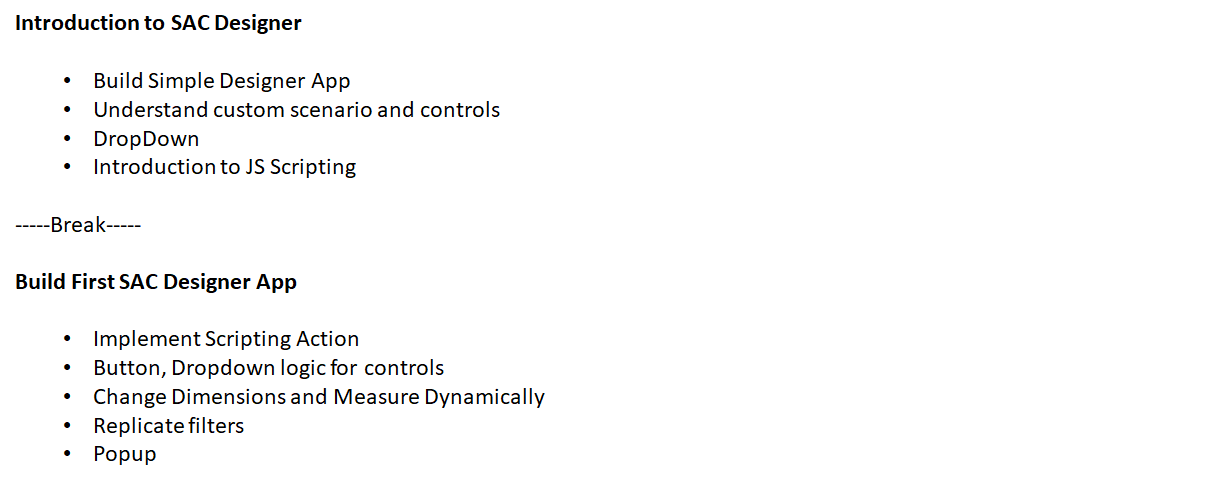
Agenda – Day 12
Understanding advance Designer Concepts
Working with Scripting Hierarchies
Transfer Context
Integrate Stories

Slide 3

SAC Designer – SAP Analytic Designer
SAP SAC analytic Designer Completes the SAP Analytics Cloud and it complements the existing pillar (BI, planning, Predict). It gives advance Scripting Capabilities with which we can design complex applications with input controls like Input, Dropdown, check box, calendar, with powerful imperative logic (IF, Loop, Conditions, Variables) using JS.
Allows us different kinds of custom scenarios which are not possible with SAC BI. In Designer we create a Application but in BI we create Stories.
Story
Application
Covers the Standard Scenario – Drag Drop
Non-programmers
Create BI Dashboard
Bi and planning use cases
Covers Custom Scenarios
Programmers
Used for Close loop scenario
Advance scripting to design end to end app
All the features can be accessed via API (Application Programming Interface) – Single Entry points/Functionality from standard
www.anubhavtrainings.com

Slide 4
Common b/w story and app
They both share the model concept
They both share some widgets – charts, table, inp, map…
Provides same experience
When to use SAC designer
Scenario 1: Interactive Designer capabilities like Lumira
Scenario 2: Integrate with Planning, BI, smart features using API (programming), Helps navigation to store access also business application. We can also embed another story or webpage inside SAC designer.
Scenario 3: Close Loop Scenario – Insight to Action
We can take action by calling REST (OData Service) to SAP S/4,ECC,BW system which updates data in system.
www.anubhavtrainings.com

Slide 5
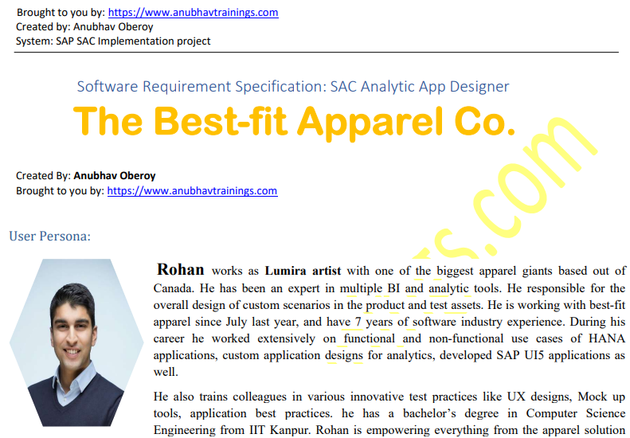
Designer Scenario
www.anubhavtrainings.com

Slide 6








































Slide 7
Basics of JS
JS is a browser’s programming language which is light weight
All browser’s directly understand JS language
It is a case-sesitive programming language
Every statement ends with semi-colon
When we create a variable the data type will be automatically decided based on value we assign
We can use = is an assignment operator, === is comparison operation
We can create variables using var or let keyword
JS offers different data objects scalar variable, array (list of values), json (java script object notation)
Every statement ends with semi-colon

Slide 8













Scalar variables
var x = 10;
x;
typeof(x);
x = "10";
typeof(x);
var y = parseInt(x);
y;
x = false;
typeof(x);
var name = "anubhav oberoy“;
name.split(" ");
var salute = "Mr. ";
salute + name;
name.indexOf("anubhav");
name.indexOf("oberoy");
name.indexOf("sharma");
name.toUpperCase();

Slide 9






Arrays
var aFruits = ["Apple","Banana","Cherry"];
aFruits;
aFruits[0];
aFruits[aFruits.length - 1];
aFruits.push('Litchi’);
aFruits;
aFruits.pop();
aFruits.splice(1,0,'Pineapple’);
aFruits;
for(var i=0; i < aFruits.length; i++){ var item = aFruits[i]; console.log(item);}
for(line in aFruits){ console.log(aFruits[line]);}

Slide 10








Object – Java Script Object Notation - JSON
var oEmp = { "empId":1000, "empName":"Anubhav", "salary":95500, "curr":"USD" };
oEmp;
oEmp.age = 35;
oEmp;
delete oEmp.age;
oEmp;
JSON.stringify(oEmp);
var str = JSON.stringify(oEmp)
JSON.parse(str);
var aEmp = [ { "empId":1000, "empName":"Anubhav", "salary":95500, "curr":"USD" }, { "empId":1002, "empName":"Sonia", "salary":8000, "curr":"EUR" }, { "empId":1003, "empName":"Rohit", "salary":70000, "curr":"INR" }]
aEmp[1];
aEmp[1].salary;

Slide 11
Sample App
Title: Sales Analysis
Filter bar (dimension filter)
69852
www.anubhavtrainings.com

Slide 12
Events
Event gets triggered when user perform an action on the screen. This event will cause a event handler getting executed. An even handler is a place where analytic designer can code the behavior (method).
SAC offers for each control pre-defined events where we can code.
https://help.sap.com/doc/958d4c11261f42e992e8d01a4c0dde25/2020.14/en-US/index.html
R Documentation
https://www.rdocumentation.org/packages/stats/versions/3.6.2/topics/cor
SAC Documentation for API
https://help.sap.com/doc/958d4c11261f42e992e8d01a4c0dde25/release/en-US/index.html
www.anubhavtrainings.com

Slide 13
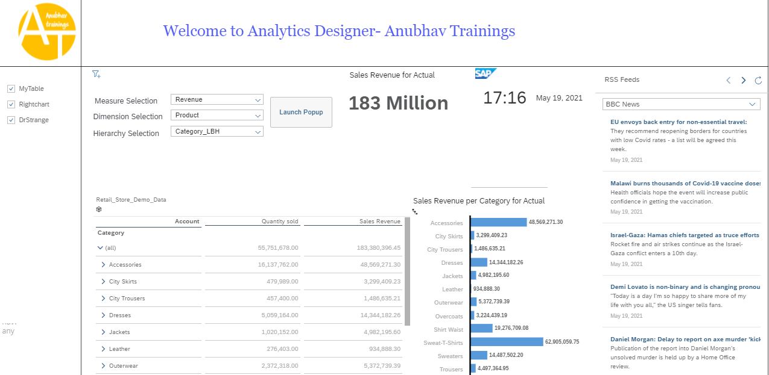
Creating Analytic Designer Application
www.anubhavtrainings.com

Slide 14

Questions?

Slide 15


Thank you
Anubhav.abap@gmail.com
contact@anubhavtrainings.com
+91 84484 54549
www.anubhavtrainings.com

